Slide 1


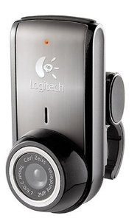
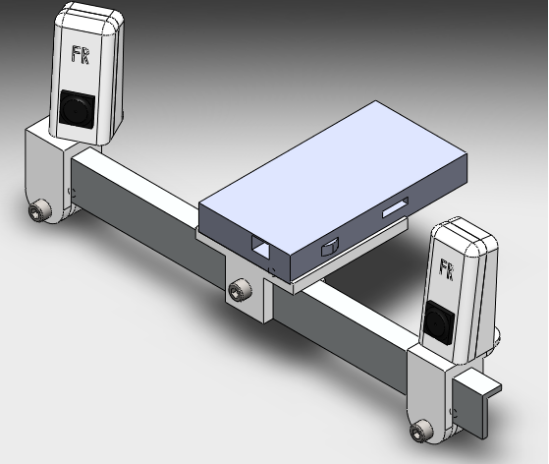
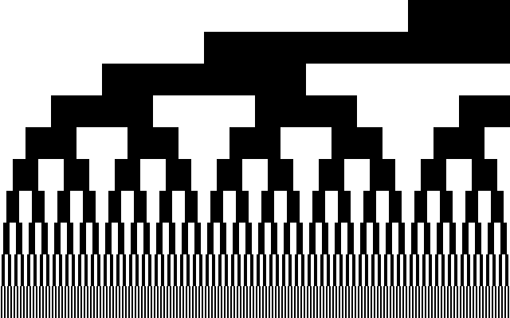

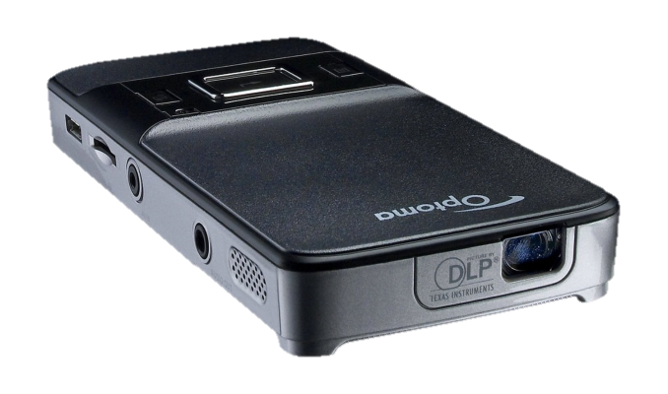
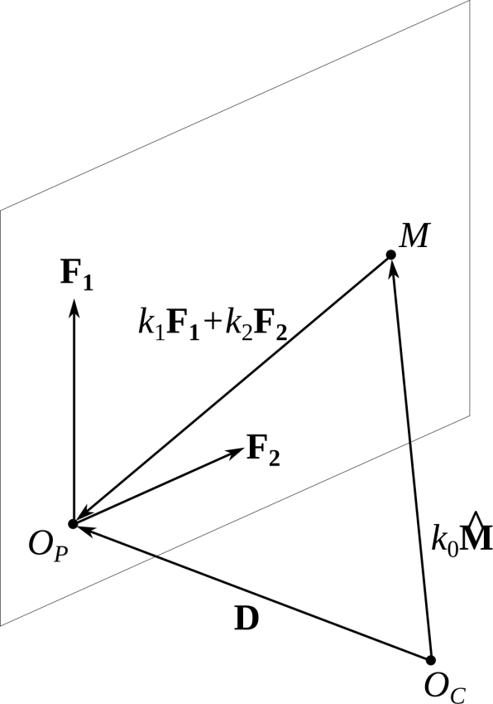
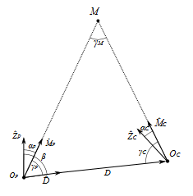
Fully Reversed Engineering: Streamlining three-dimensional component digitization, modification, and reproduction
CHSLT – ME
Center for Holographic Studies and Laser μmechaTronics
Ryan Muller and Chris Thomas
Advisor: Cosme Furlong Mechanical Engineering Department
1. Objectives
4. Testing the concept through simulation
7. Results
To design a system for rapid digitization of physical objects for the purpose of reverse engineering
To create a low cost alternative for expensive digitization solutions
To create a streamlined process for digitization that requires minimal user interaction
We tested the binary method through simulating using the open-source software POV-Ray.
A sphere was scanned and radii were fitted to cross sections of the point cloud.
2. Motivation
The ability to quickly digitize a part allows a designer to easily reproduce a component for which CAD files are not available, or allows the designer to create accessories for such components.
For example, Jay Leno uses the NextEngine 3D scanner to quickly reproduce parts for antique cars whose details have been lost to history.
However, current scanners on the market are costly—the NextEngine, for example, costs $2995.
The goal of this project is to build a full field-of-view digitization system at significantly lower cost.
Axis | Mean Radius(m) | Standard Deviation (um) | Error (um)
x | 0.149992 | 21.12 | -7.92
y | 0.150002 | 16.12 | 1.94
z | 0.149996 | 25.00 | -3.62
Mean | 0.149997 | 20.75 | -3.20
5. Hardware
8. Conclusions and future work
3. Structured light reconstruction concept
Logitech C905 Webcam
2 MP, 2.8μm cell size, 50 mm min. focal length
Project binary patterns onto object
Project sinusoidal fringes onto object
Optoma PK201 Projector
854 px horizontal resolution, DLP projection, throw ratio 2.2
Capture patterns
Capture patterns
Calculate difference between images
Calculate phase
Cameras: 2 × Logitech C905 Webcam $100
Projector: 1 × Optoma PK201 Pico $250
Parts: Rapid-prototyped from ABS $ 10
Beam: Aluminum L-beam $ 6
Total cost: $366
Compute pixel indices
Convert phase to pixel indices
Calculate angle between optical axis of projector and each point on object
6. Scanning process
Setup
Use camera/projector geometry to recover point cloud
Position equipment
Camera calibration
Create mesh from point cloud
Projector calibration
Single view
Combine views
(a)
Data acquisition
Reposition object
Decoding and triangulation
Calculate new orientation
Point cloud
Align point clouds
9. acknowledgements
Mesh
10. References
Notes:
Put the two otoscopes together – may be put a diagram of what’s inside

